Slide 1
Webinar series
"WHAT'S IN IT FOR ME?"
Thursday 19 September 2024
HOW TO ENGAGE YOUR COMMUNITY IN ACCREDITATION PROJECTS

Slide 2
HEADway Advisory
Strategy consulting
Analysis & strategic planning
Organizational and digital transformation
Mergers and acquisitions
Executive search and HR challenges
General, functional, or unit leaders
Academic management, full Professors
Organizational analysis and development
Accreditations, certifications, and quality
National challenges (RNCP, Qualiopi, Visa, Grade, CGE, CTI...)
International challenges (AACSB, EFMD, AMBA, BGA...)
Structuring of quality processes
Information & Data
Specialized Newsletter
Quantitative and qualitative analyses

Slide 3
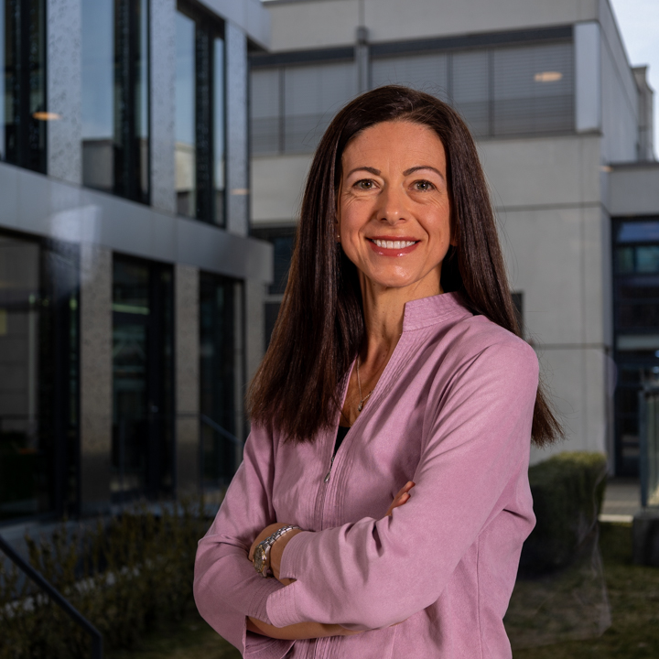
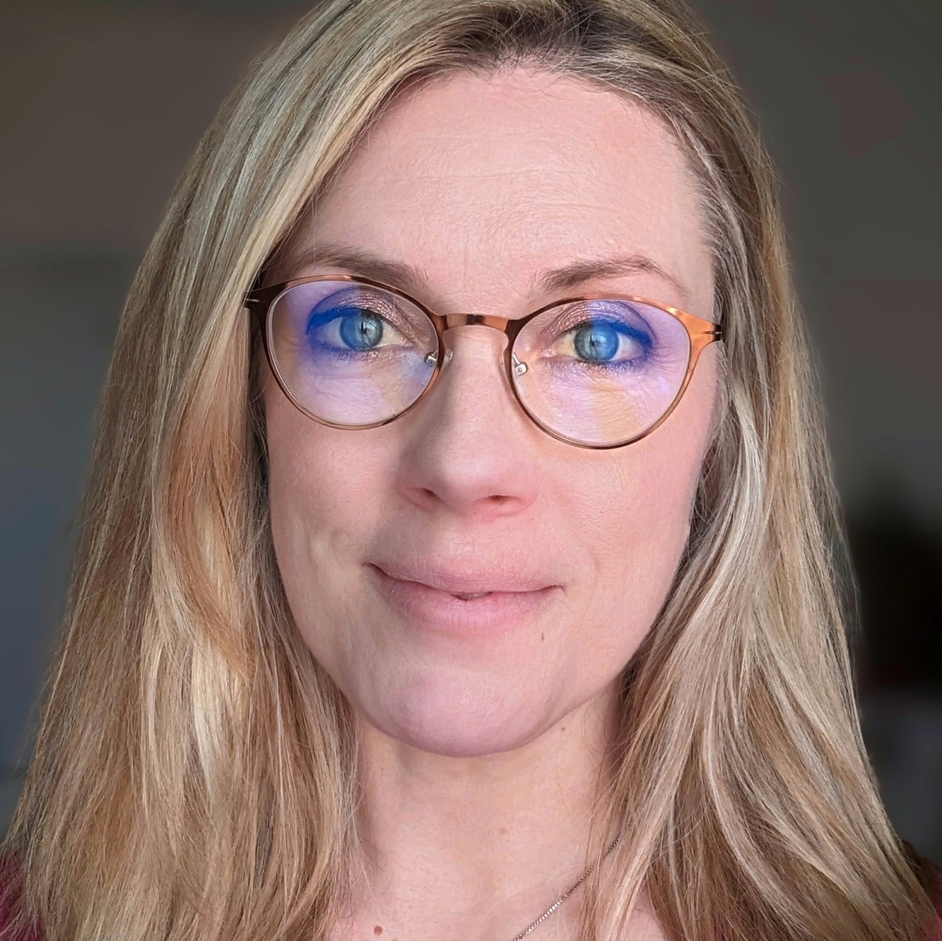
INTRODUCTION OF PRESENTERS
Nathalie L'Huillier
Mélanie Cadart
Accreditation & Certification Manager
Senior Manager
EHL Hospitality Business School
HEADway Advisory - Quality & Accreditation
Switzerland
France

Slide 4
1. INVOLVING A DIVERSE FACULTY
Challenge
Diverse Faculty Perspectives may not immediately see their connection to accreditations, and some faculty may feel disconnected from the process.
Solution
Foster awareness by emphasizing how their expertise contributes to the institution’s overall success.
Highlight the crucial role of all faculty in shaping students’ holistic education and the institution’s impact.

Slide 5
2. ROLE OF ACCREDITATION MANAGERS AS "CHIEF SUCCESS CELEBRATION OFFICERS"
Challenge
Accreditation may be perceived as focusing on compliance rather than celebration.
Solution
Celebrate milestones: Acknowledge achievements during the accreditation process and encourage self-reflection on how each individual contributes to fostering excellence.
Leverage success stories: Share faculty and student accomplishments as exemplars in accreditation reports.
Create a positive atmosphere: Foster pride and motivation around accreditation or quality assurance efforts.

Slide 6
3. MISSION AS A RALLYING INSTRUMENT
FOR INTERNAL STAKEHOLDERS
Challenge
Ensuring engagement in the accreditation process beyond compliance.
Solution
Leverage the mission as a unifying force:
Students: Show how accreditation enhances their learning experience.
Staff: Emphasize how accreditation supports institutional values and goals.
Faculty: Connect accreditation efforts to teaching and research impact, regardless of discipline. Encourage research related to community needs and involve faculty in defining measures of impact.
Institution: Highlight continuous improvement as the ultimate goal, with accreditation being a key component of this journey.

Slide 7
THANK YOU

